Slide 1
While Loops
Tutorial #13

Slide 2
OBJECTIVE

Slide 3
Objective
By the end of this tutorial, you should understand how to write a loop.

Slide 4
TEXTPLANATION

Slide 5
Textplanation
One of the most frequently asked questions I get regarding loops is, “When do you use a loop?” Invariably, my answer is, “When you need one.” This is not me trying to be clever or funny. A loop, just like every other coding tool, is meant to be used when you have a problem that needs it for the solution.

Slide 6
Textplanation
A loop is a way of repeating the same code over and over again. Usually, you’re performing a loop until some condition is met. Like, keep looking out the window until the cab gets here. That’s a good loop. You’re waiting for the cab and you keep going to the window to see if it’s arrived. Once it shows up, you won’t need to look out the window again.

Slide 7
Textplanation
A loop in code works on the same premise, but all of your conditions are set up like...conditionals. There are a couple of different types of loop syntax, but a while loop is the easiest to learn up front because it’s really just a repeating if.

Slide 8
Textplanation
x = 0;
if (x < 10)
{
x++;
}
The code on the left will take x, which starts at 0, make it 1, and go along on its merry way. But look at the code on the right.
x = 0;
while (x < 10)
{
x++;
}

Slide 9
Textplanation
All I did was swap out the if for the while. But the execution is very different. Instead of adding 1 to x and moving on, it will add 1 to x and head back to check the condition again. If the condition is still true, which it will be after the first iteration (that’s a fancy word for cycle), it will do it again. And again and again. It will keep doing it until x is no longer less than 10 (which, in case you’re trying to figure that out, is when x reaches exactly 10).

Slide 10
CONSTRUCTION

Slide 11
Construction
Create a folder somewhere on your drive and label it While Loops.
Open up notepad++.
Save the empty file to your folder and name the file “index.html”.
All first pages on a website are called index.
As you go through the images of the construction, add to your code. You will see comments with explanations of what you are doing. Those comments will change with each slide. You should not type my comments into your code.

Slide 12
Construction
It’s Halloween and you’ve got a bowl full of candy. As each child comes to the door, you hand out one piece of candy (cheapskate) at random. With the computer simulating this behavior, it will have to be aware of pieces of candy running out. We’ll use loops to simulate this.

Slide 13
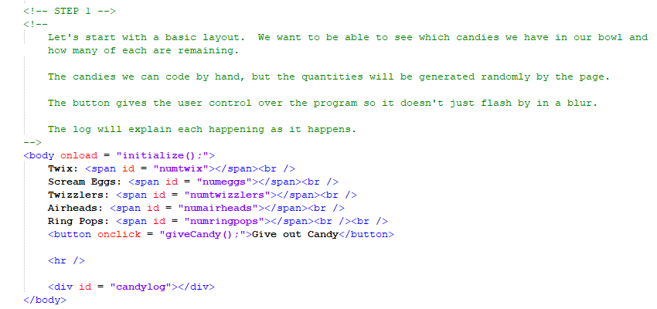
Construction

Slide 14
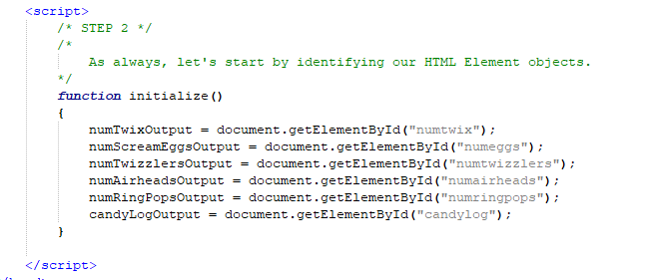
Construction

Slide 15
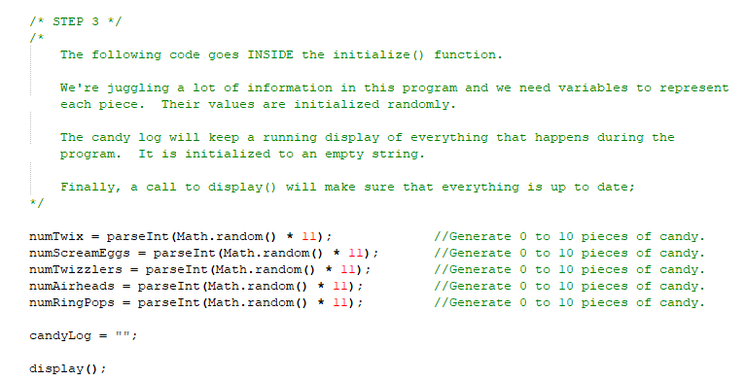
Construction

Slide 16
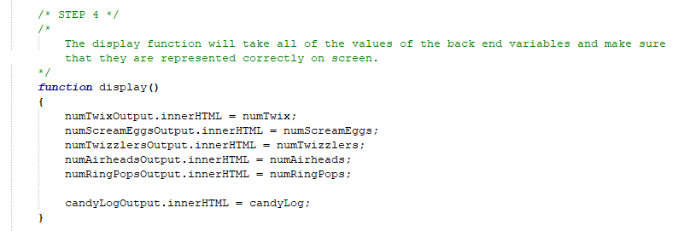
Construction

Slide 17
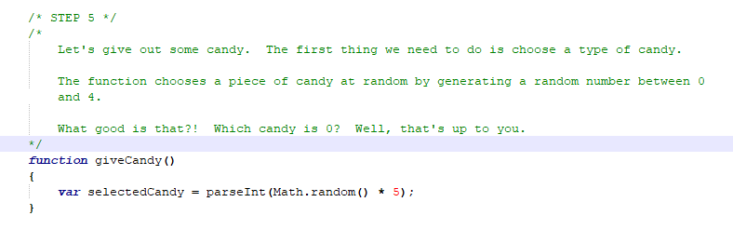
Construction

Slide 18
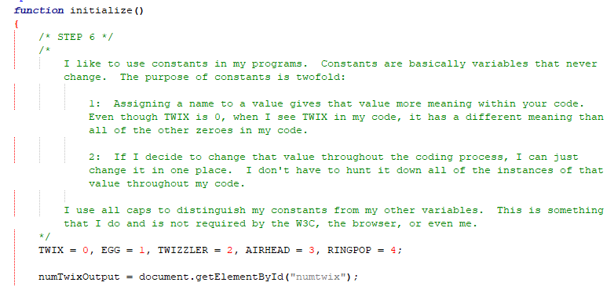
Construction

Slide 19
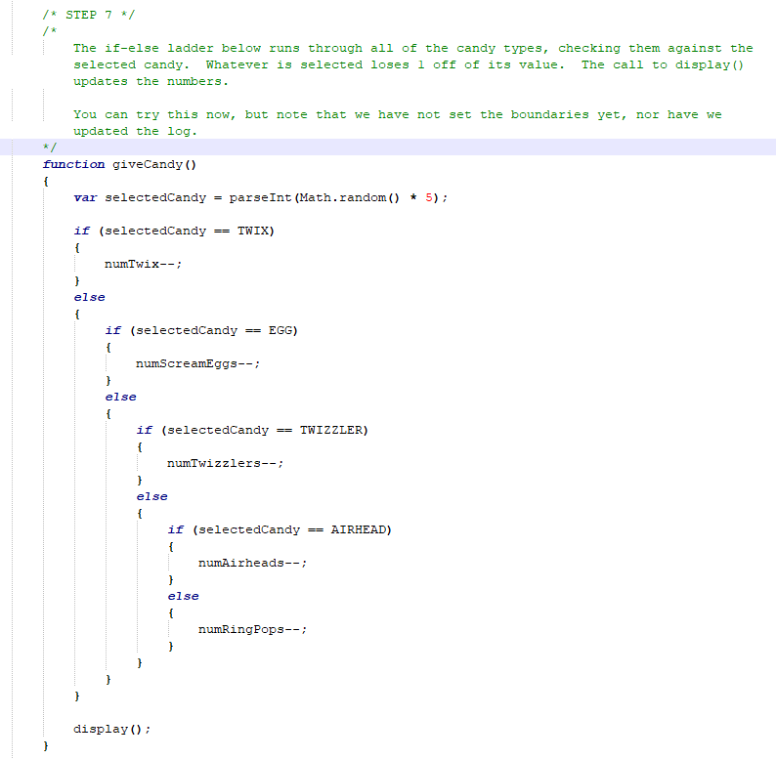
Construction

Slide 20
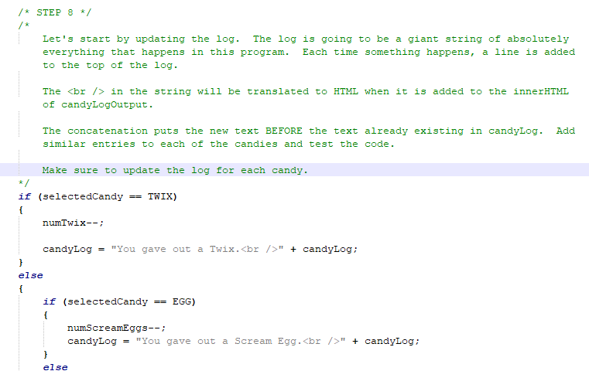
Construction

Slide 21
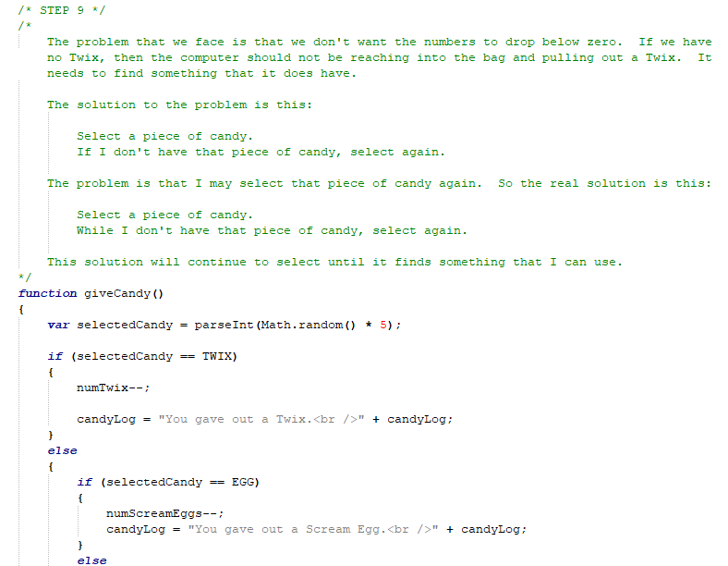

Slide 22
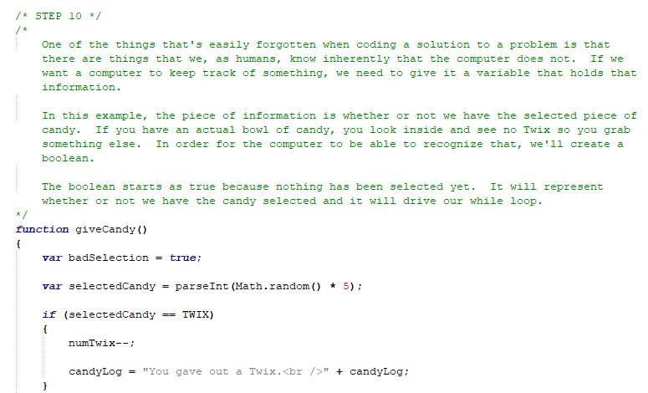
Construction

Slide 23
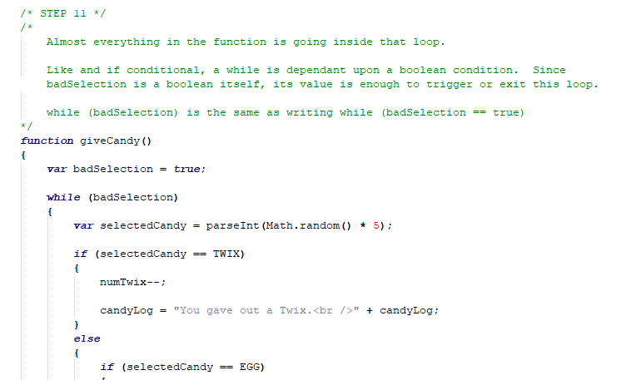
Construction

Slide 24
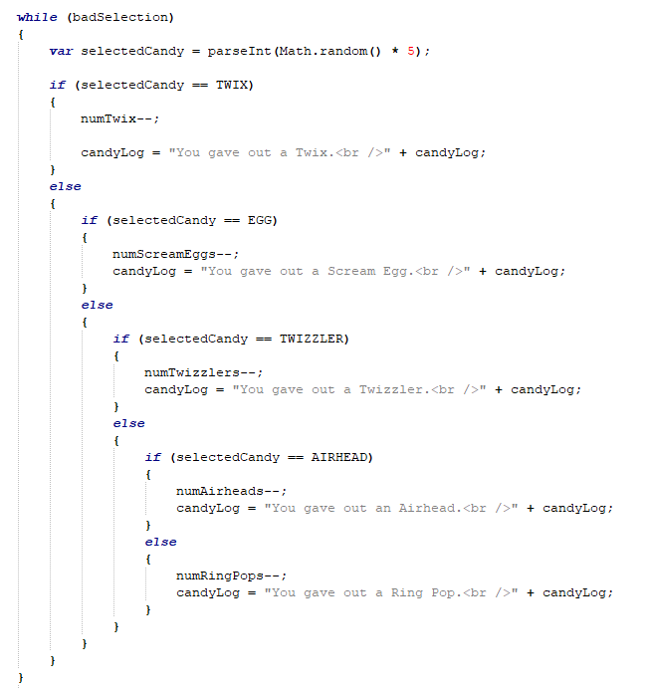
Construction

Slide 25
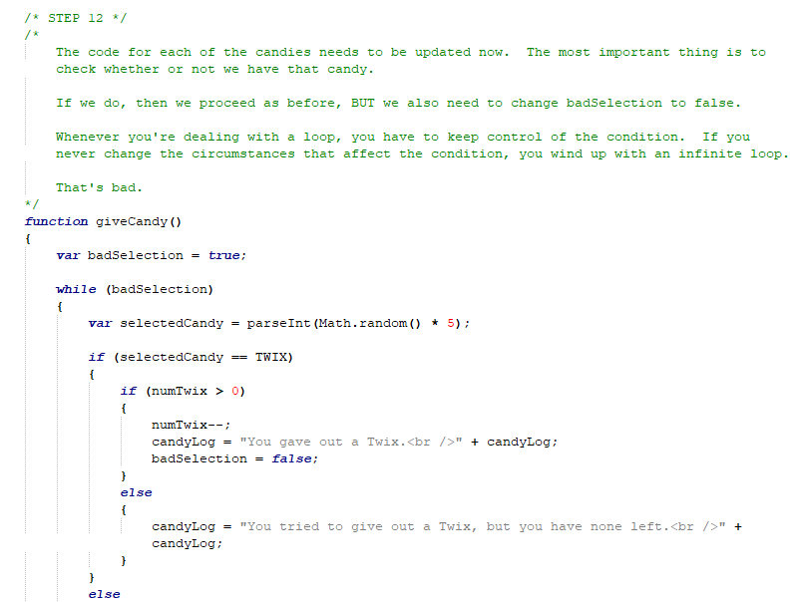

Slide 26
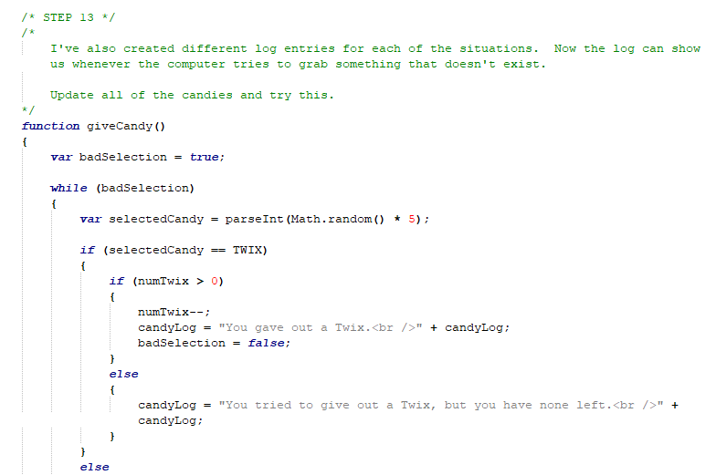
Construction

Slide 27
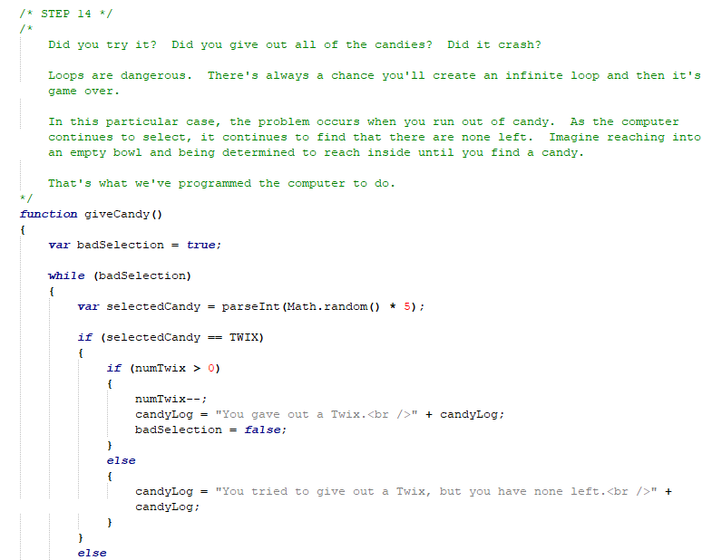

Slide 28
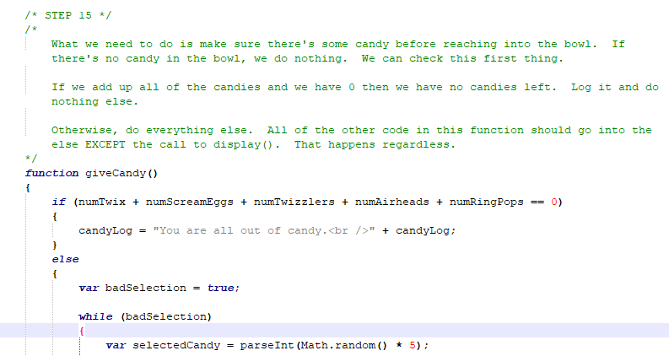
Construction

Slide 29
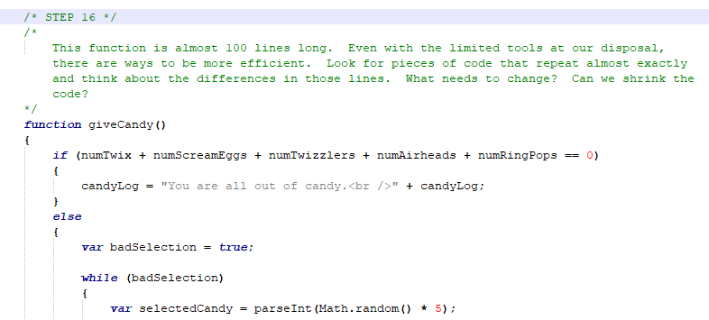
Construction

Slide 30
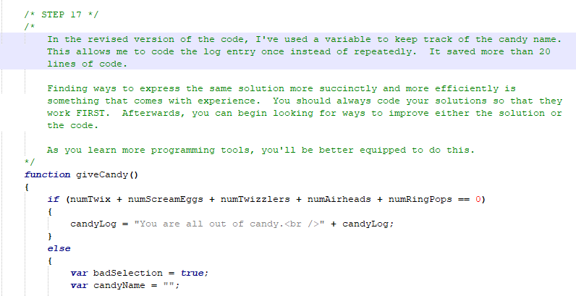
Construction

Slide 31
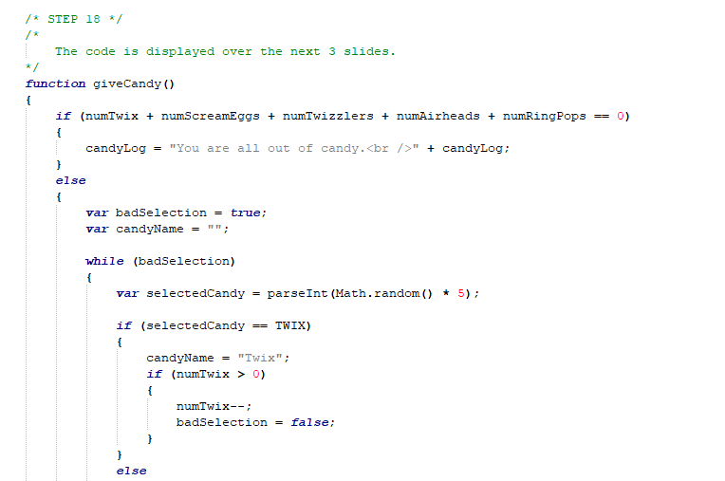
Construction

Slide 32
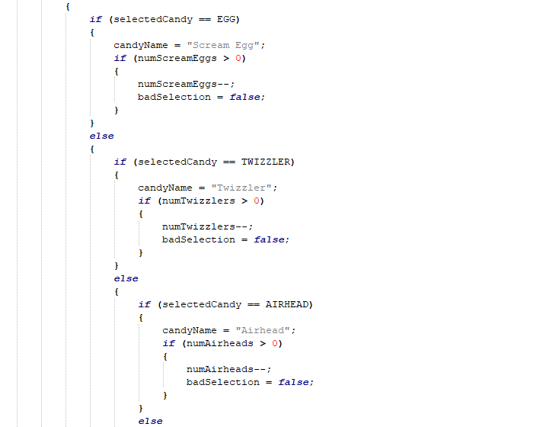
Construction

Slide 33
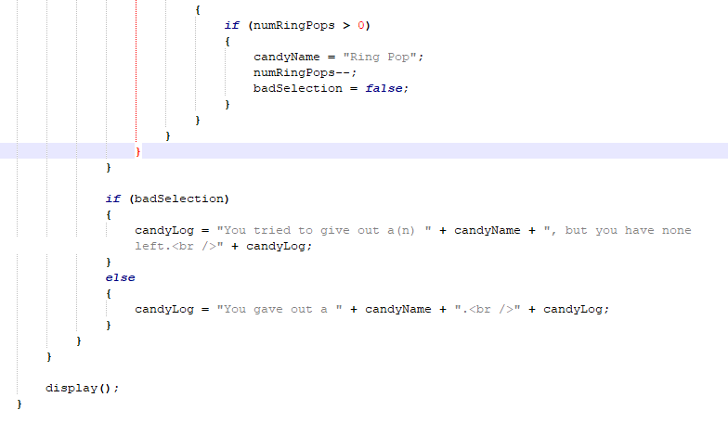
Construction

Slide 34
A DEEPER MEANING

Slide 35
A Deeper Meaning
Let’s consider again, the question, “When do you use a loop?” We tend to approach things from a very singular perspective. If you’ve been asked to write a program, you want to start writing the program right away. The truth, however, is that a program is really just the implementation of the solution to a problem.

Slide 36
A Deeper Meaning
Stay with me here.

Slide 37
A Deeper Meaning
A program is the implementation of a solution to a problem.

Slide 38
A Deeper Meaning
There are three very important objects in that statement. The program. The solution. The problem.

Slide 39
A Deeper Meaning
You’re given the problem going in. From there, you need to work out the solution. That’s the step that often gets skipped. Coding is easy if you know what you want to code. If you haven’t worked out the solution, however, you wind up trying to solve the problem through code, which is difficult and unnatural.

Slide 40
A Deeper Meaning
Solve the problem first. Work it out, step by step. And then code the solution.

Slide 41
A Deeper Meaning
If you do that, you’ll know whether or not you need a loop. You’ll also know when you need an if conditional, separate functions, which variables you’ll want, what color shirt you want to wear, and how much pizza you need to eat in order to be satisfied.

Slide 42
FAQ

Slide 43
FAQ
When do you use a loop?
When you need one.

Slide 44
FAQ
What’s the difference between a while loop and a for loop?
Functionally, nothing. You can do anything with a while loop that you can do with a for loop and vice versa. For loops, however, are syntactically designed for iterating (fancy word for cycling) through data structures (lists of information).

Slide 45
FAQ
What’s a for loop?
You’ll find out.

Slide 46
ACTIVITY

Slide 47
Crack the Color Code
Just how long will it take the computer to crack a code?
Create 3 variables, red, green, and blue, and assign each a random number between 0 and 255.
The computer must try and figure out that color by randomly guessing the red, green, and blue values individually.
As it guesses, change the background color of the screen (this is going to change very fast) and log the guesses.
Once it has the right color, stop.

